Slide 1
ETL Project Presentation
Oluwatobi Akinsanya
Temidayo Akinsanya

Slide 2

Cyber Breaches and Common Passwords

Slide 3
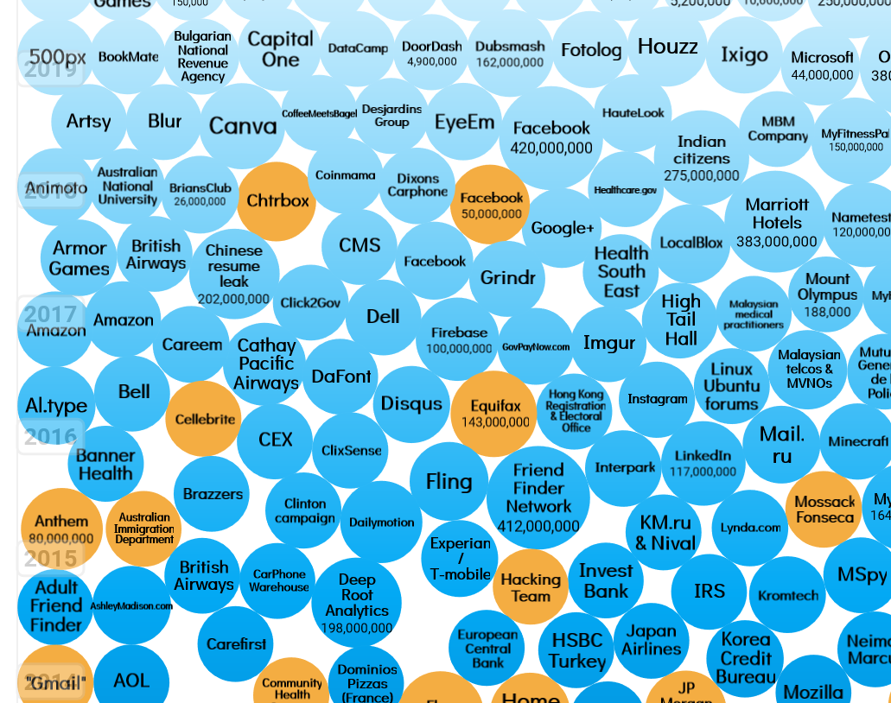
350+
10,000

Slide 4

Data Source
Comma Separated Values (CSV) document
Wikipedia Web Page

Slide 5


Data Extract
BeautifulSoup for webscraping
For Loop extract list

Slide 6

Data Transformation
Removing excess data
Removing certain null data
Renamed columns
Checked for duplicates

Slide 7

Data Load

